Slide 1
AI Powered Road Sign Detection
The Signal Saviors Danielle S. Raynor, Kevin Allen, Adnan Hasan, Sahad Rafiuzzaman, Noah Roberson

Slide 2
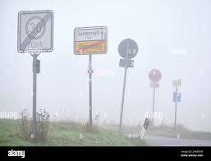
Problem Statement
Challenge
With rapid expansion in road networks and varying road signs poses a challenge for consistent detection, especially in autonomous and driver-assistance systems.
Key Issues
Recognition Difficulties: Varying lighting, weather conditions, and partial occlusions impact sign visibility.
Safety Risk: Misinterpretations of road signs can lead to potential traffic violations and accidents.

Slide 3
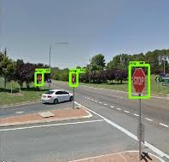
Problem Solutions
Objective
Develop an AI-based solution that accurately detects and interprets road signs in real-time.
Approach
Use CNNs for fast, efficient feature extraction and classification.
Real-Time: Optimized for instant decision-making.
Model
CNN Architecture: Designed for reliable road sign detection.
Data
Diverse Datasets: Training across varied conditions (lighting, weather, occlusion) for improved accuracy.

Slide 4
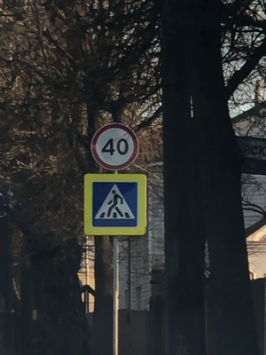
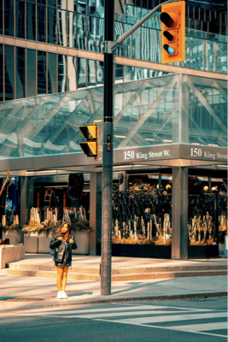
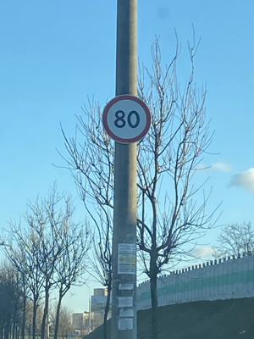

Dataset Description
Dataset Overview:
Images of various road signs, categorized into classes like traffic lights, stop signs, yield signs, and speed limit signs.
Each image is paired with a label identifying the type of road sign.
Data Structure:
Primarily unstructured with images in different resolutions and formats.
Project Relevance:
Investigate the impact of data poisoning by generating and adding altered images designed to mislead the model.
Dataset Source:
https://www.kaggle.com/datasets/andrewmvd/road-sign-detection
877 images and 4 different classes.

Slide 5






Tools & Technologies
Development Tools
Python: Core programming language for AI model creation and development.
Libraries
TensorFlow & Keras: Model building and training for robust neural networks.
OpenCV: Handles image processing task for sign detection.
Scikit-learn: Evaluates model performance and calculate metrics.
Platform
Google Colab: Provides an interactive, cloud-based development environment for efficient coding, data analysis, and documentation.

Slide 6


Expected Output
Goal Develop a trained AI model capable of accurately classifying road signs under standard conditions.
Performance Metrics
Accuracy: Overall correctness of classifications.
Precision: Correctly identified road signs out of all positive predictions.
Recall: Correctly identified road signs out of all actual positives.

